Slide 1








Customer Churn Analysis and Prediction – EDA & Modeling
Praveenkumar A

Slide 2




Objective
Understand customer churn behavior
Identify important churn factors
Balance dataset for fair predictions
Build a machine learning model to predict churn
Provide business insights for retention strategies
Deploy churn prediction as a business tool

Slide 3
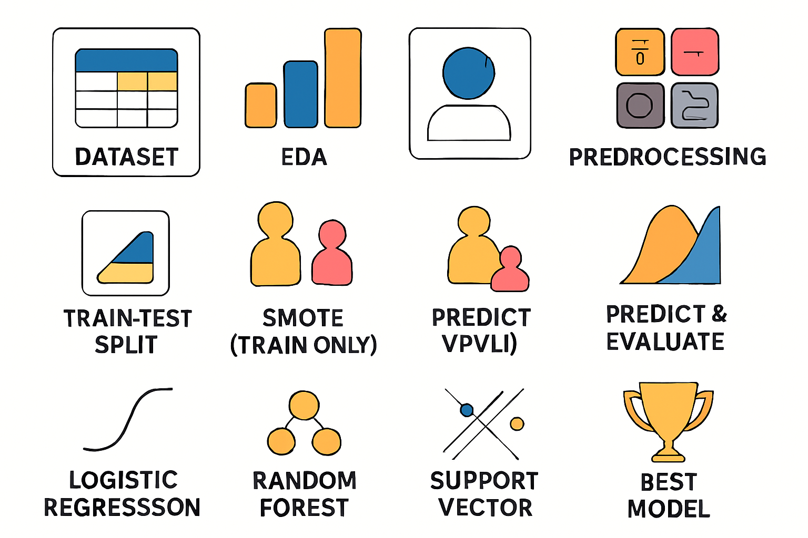
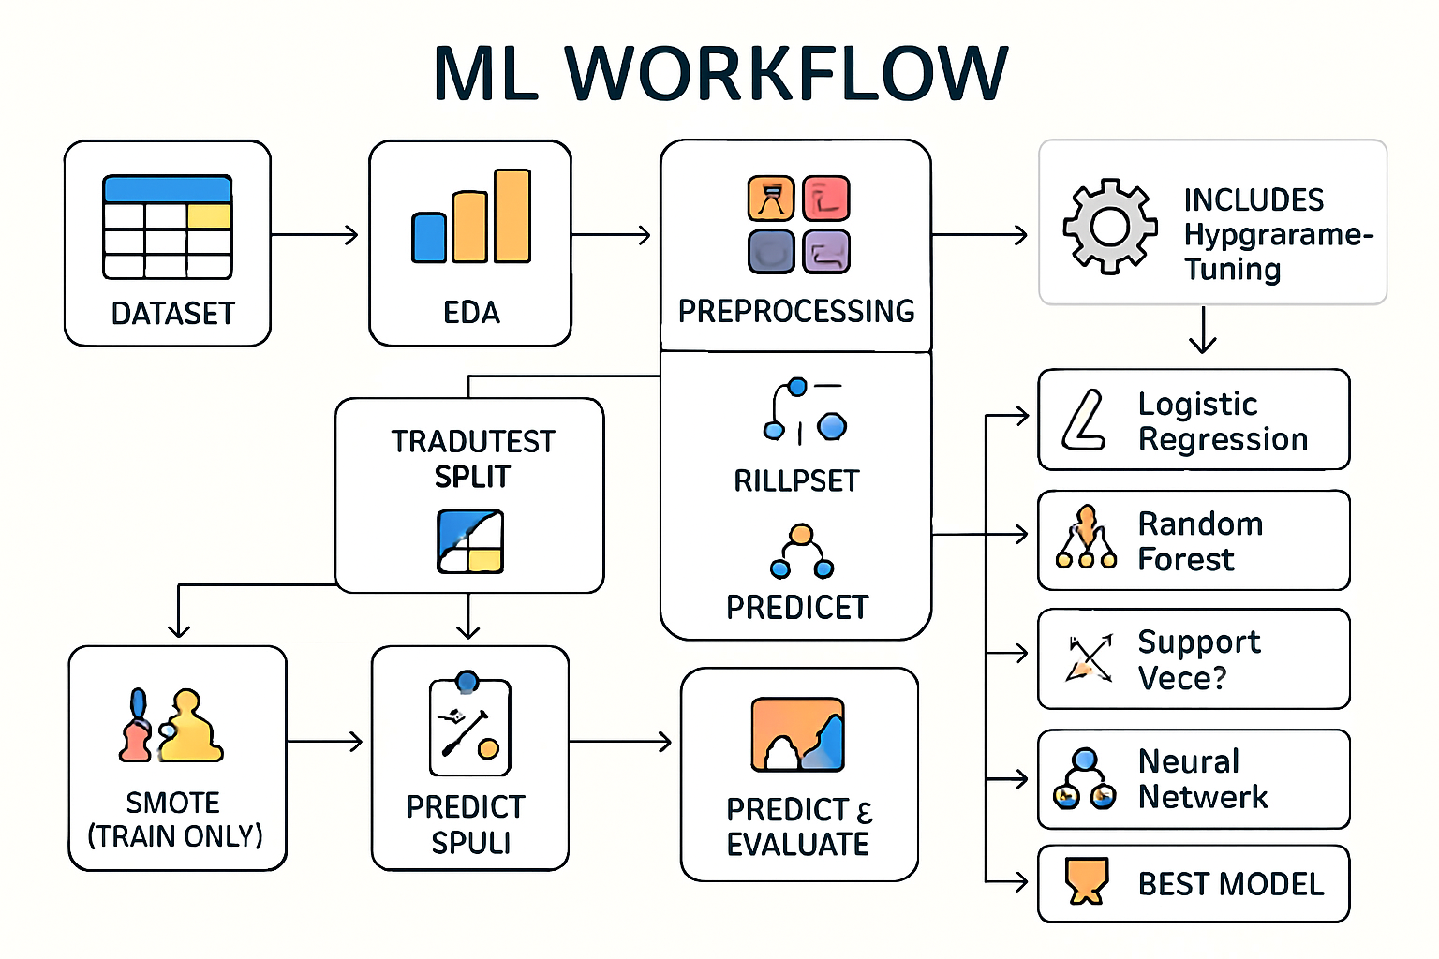
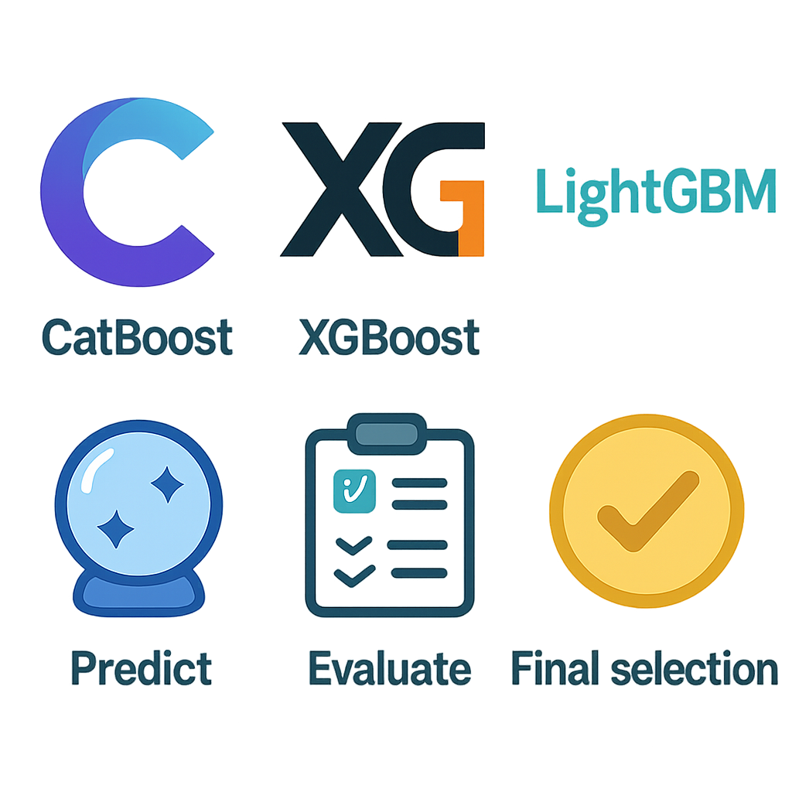
Workflow
Load the data Set
Analyse the data -Identify Patterns , relationships
Scaling
Scaling & Class Balancing
Split the Dataset
Train / Test
80-20
Encoding-Replacing Null -Dropping Unwanted Columns
Model Optimization
Model Training
Predicting the output
Observe the metrices from all model
Choose the best model by the score

Slide 4

Challenges Faced
Imbalanced dataset (more 'No' churn than 'Yes')
Missing values in TotalCharges
Incorrect Total Charges
Converting categorical features into numerical form
Selecting important features
Avoiding model overfitting while keeping good accuracy

Slide 5


EDA
Data Cleaning (handling missing values)
Data Transformation (encoding categorical variables)
Univariate Analysis (Churn distribution, tenure, monthly charges)
Bivariate Analysis (Contract type vs Churn, Internet service vs Churn)
Correlation Analysis for numerical features
Visualizations: bar charts, pie charts, histograms, heatmaps

Slide 6
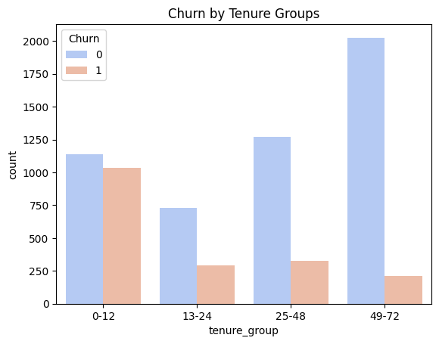
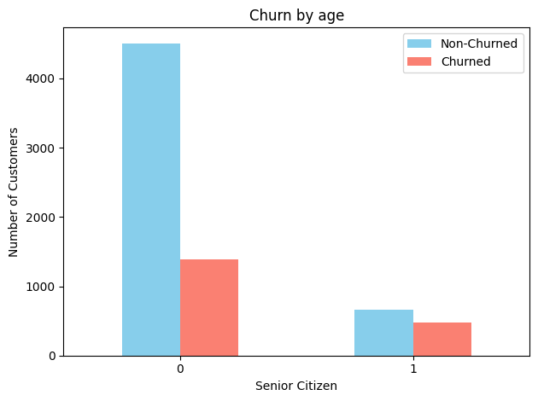
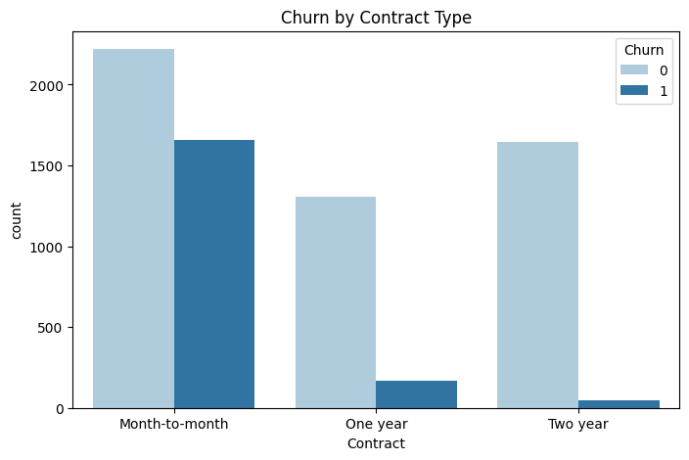
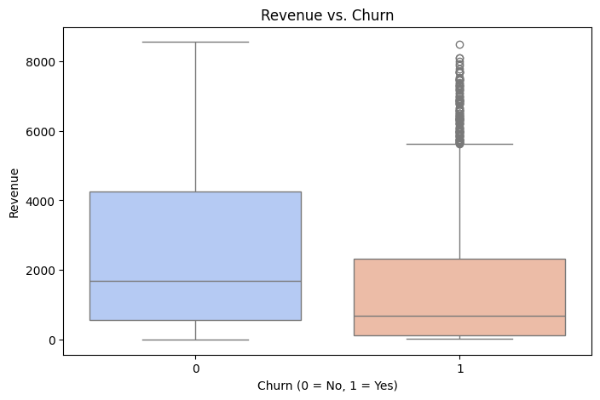
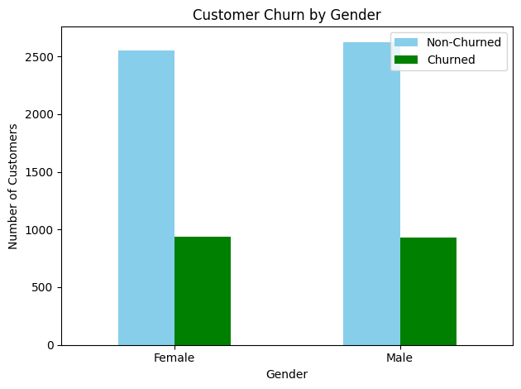
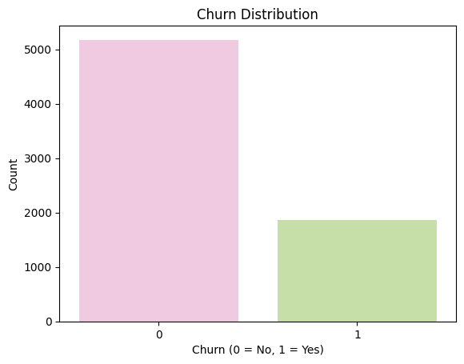

Slide 7




Data Pre-Processing
Replaced null values & Removed CustomerID column
Feature Encoding: Converted categorical → numerical.
Defined Services seperately
Used StandardScaler / MinMaxScaler.

Slide 8
Handling Data Imbalance
Applied SMOTE (Synthetic Minority Oversampling Technique) the target variable [ “Churn=yes” ] is imbalanced
Churn = No → ~73%
Churn = Yes → ~27%
Without balancing, models may learn to just predict "No" always and still achieve high accuracy.
SMOTE creates synthetic samples of the minority class so both classes are balanced.
Moderate imbalance .
Logistic Regression, SVM → are very sensitive to imbalance. SMOTE improves recall for "Churn".
Before Smote Data Shape : (5634, 19) (5634,)
Train Shape after SMOTE: (8278, 19) (8278,)
---Now both class are in balanced State ⚖️ ---

Slide 9




Modeling
LR / RF / SVM / Light GBM / XGBoost / CatBoost for churn prediction
HyperParameter Tuning have been done for Above Models
Evaluation using Confusion Matrix, Accuracy, Precision, Recall, F1-Score
Feature importance analysis to identify key churn drivers

Slide 10
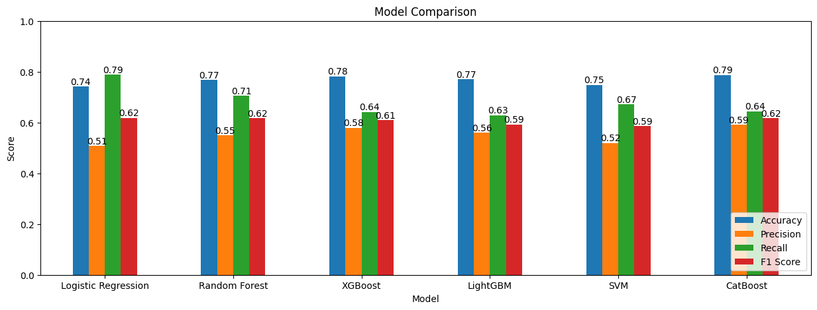
--- Summary of Model Results ---
Random Forest:
Support Vector Machine:
LightGBM
Accuracy: 0.77
Recall for Churn: 0.57
Accuracy: 0.78
Recall for Churn: 0.65
Accuracy: 0.78
Recall for Churn: 0.63
Logistic Regression:
XGBoost :
CatBoost :
Accuracy: 0.74
Recall for Churn: 0.79
Accuracy: 0.78
Recall for Churn: 0.64
Accuracy: 0.79
Recall for Churn: 0.64
Different Prameters may give different score
I’ve used Label Encoding
OneHot Encoding may give better result for SVM , LR

Slide 11

Insights
Higher monthly charges increase churn probability
Month-to-month contract customers are more likely to churn
Customers with longer tenure are more loyal
Internet service type influences churn rates
Feature importance shows tenure, contract type, and charges are critical factors

Slide 12
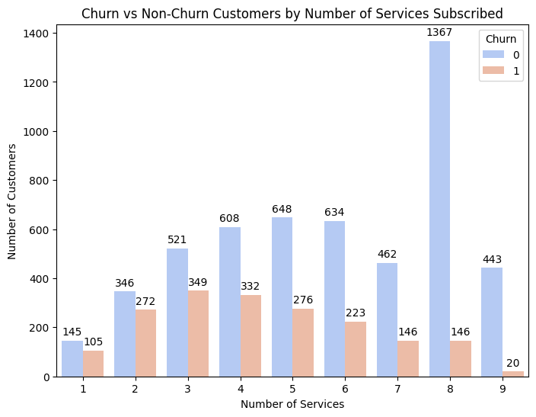
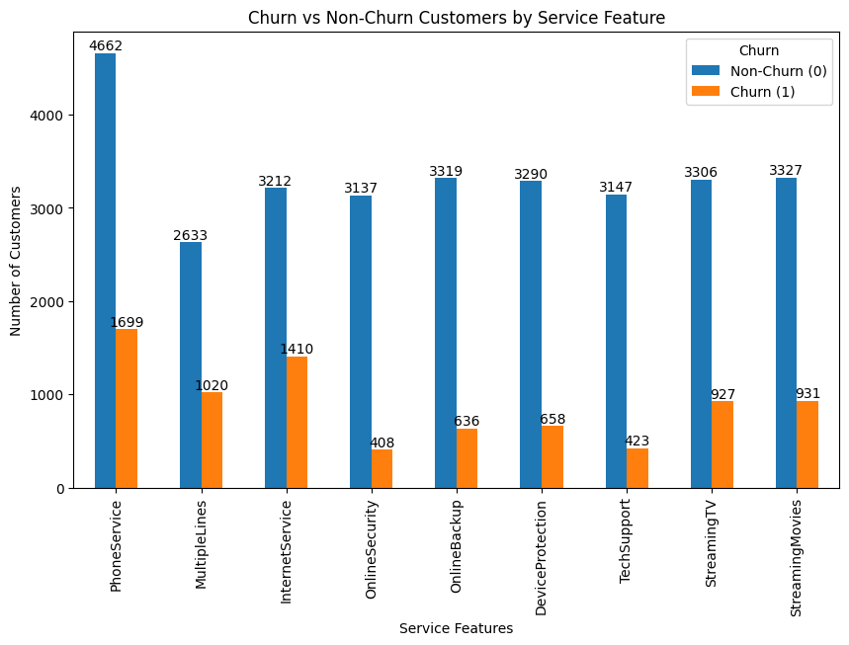
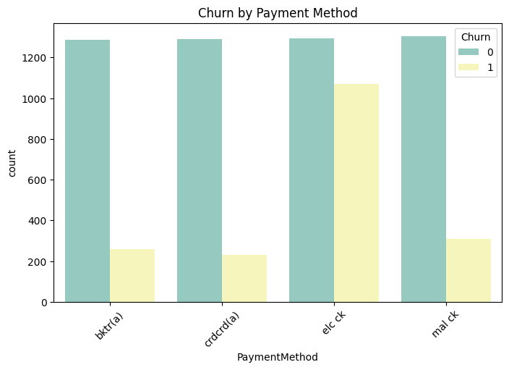
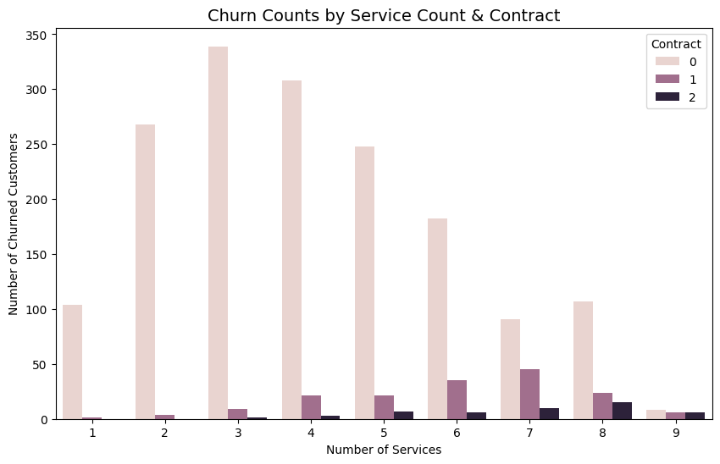

Slide 13





Business Value
Reduce customer loss through proactive strategies
Increase customer lifetime value
Improve customer satisfaction with personalized offers
Use results to design targeted retention offers

Slide 14
Conclusion
EDA revealed key patterns behind churn
SMOTE balanced the dataset for fairer predictions
CatBoost provides the most Accuracy
Logistic Regression provided reliable churn prediction
Insights can guide customer retention strategies
Future improvements include real-time prediction and advanced ML models

